Slide 1
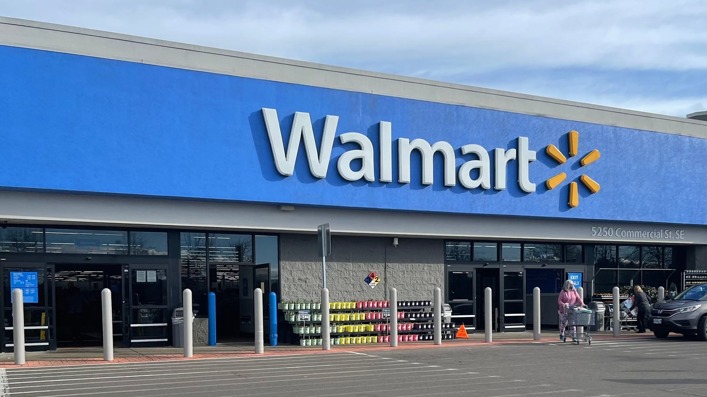

Slide 2
Walmart
We decided to predict the differences in weekly sales of Walmart the american retailer

Slide 3
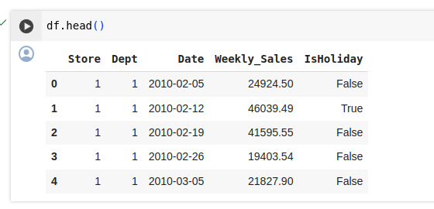
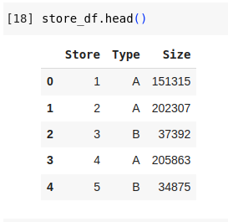
Tables of the sales and the stores information

Slide 4
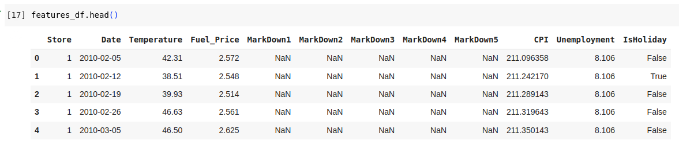
Another table that has information on the store in a specific week

Slide 5
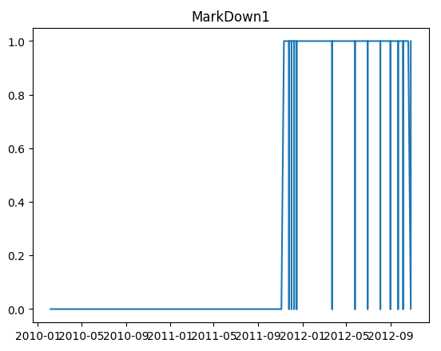
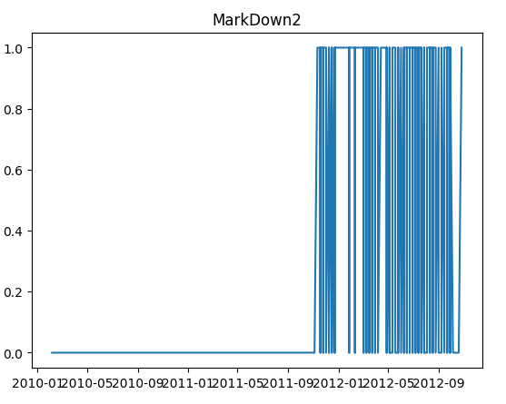
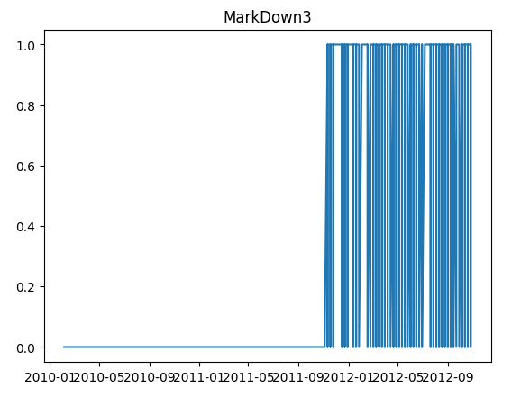
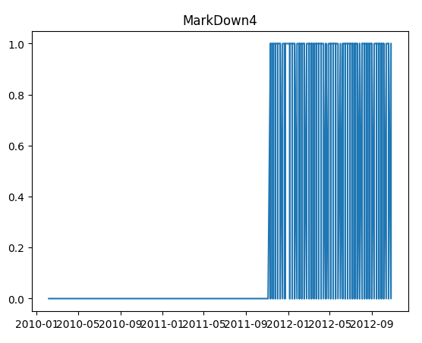
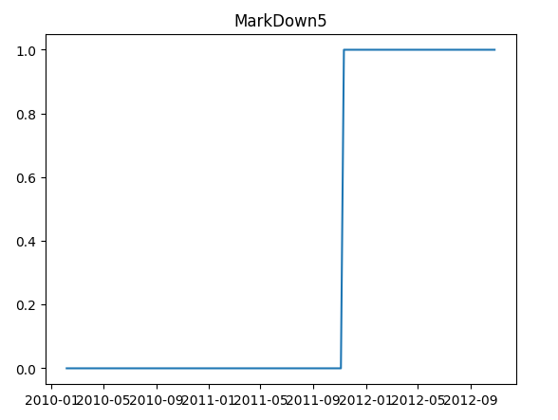
We decided to remove feautures
MarkDown1
MarkDown2
MarkDown3
MarkDown4
MarkDown5
Since they exist only since 2012 and even then are lacking

Slide 6
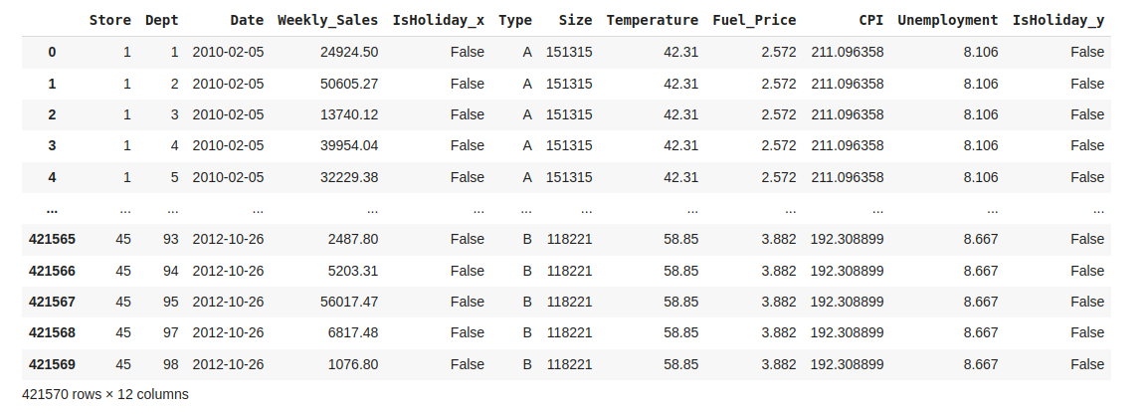
Joined table

Slide 7
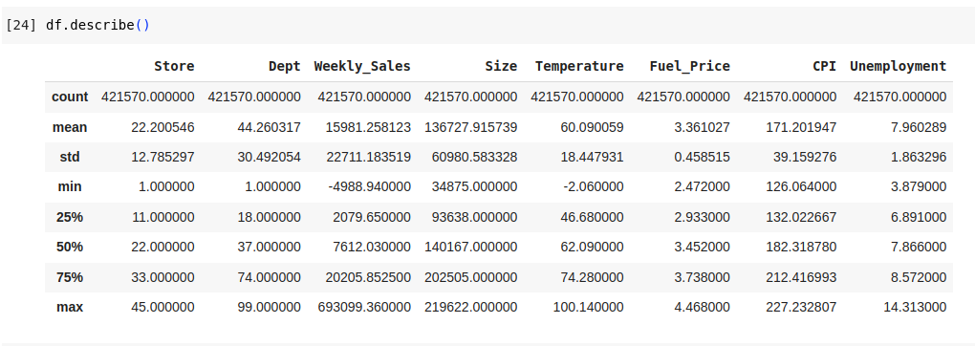
General Statistic information

Slide 8
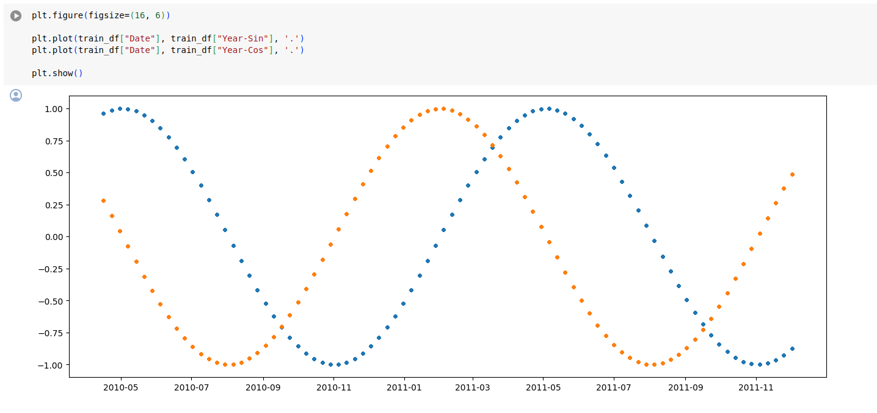
Keeping track of time with sin and cos

Slide 9
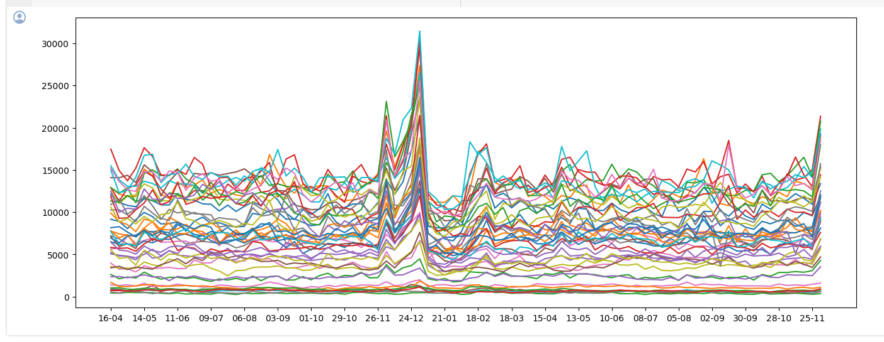
Median of the sales for each department
thanksgiving
christmas

Slide 10
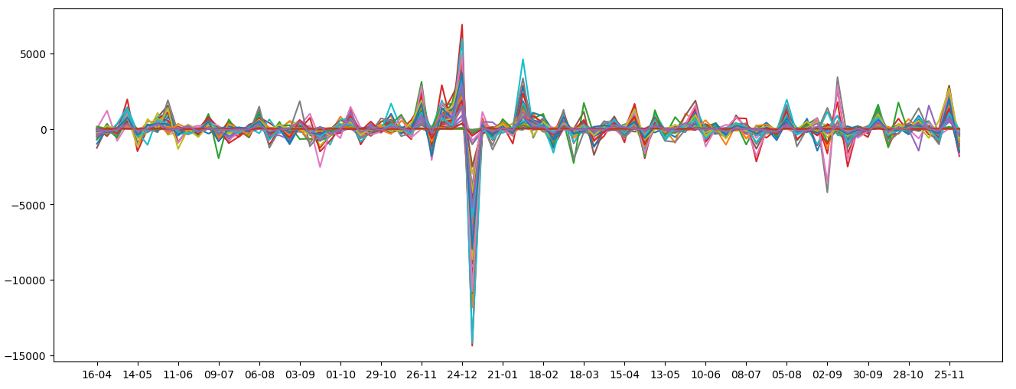
Median of the weekly difference in sales for each department
christmas
thanksgiving

Slide 11
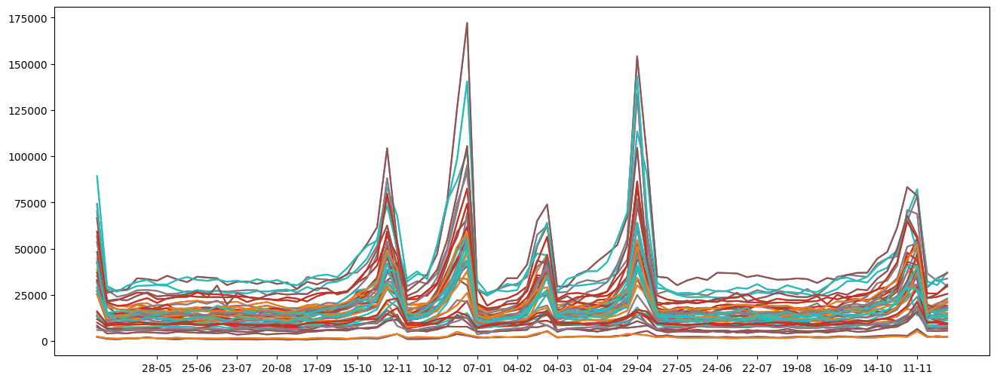
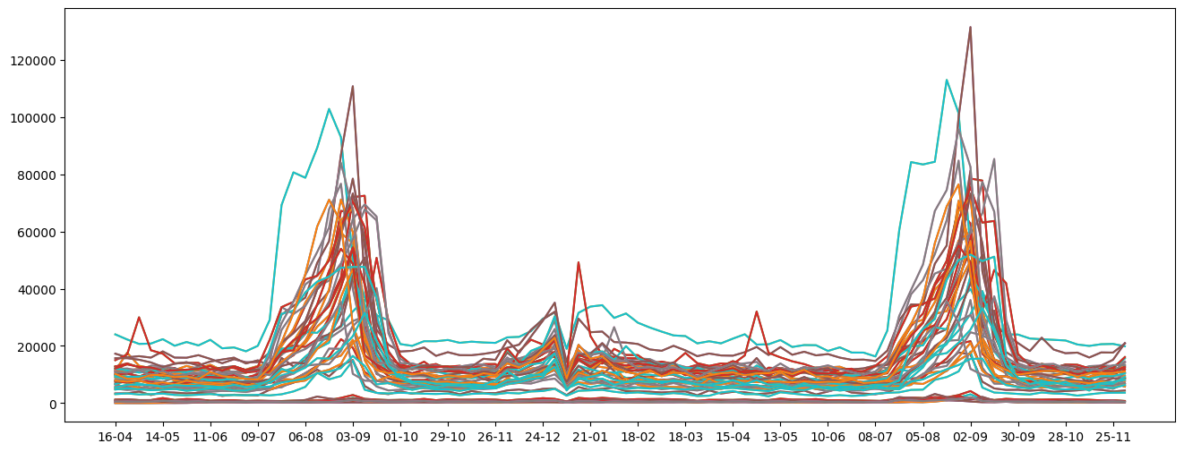
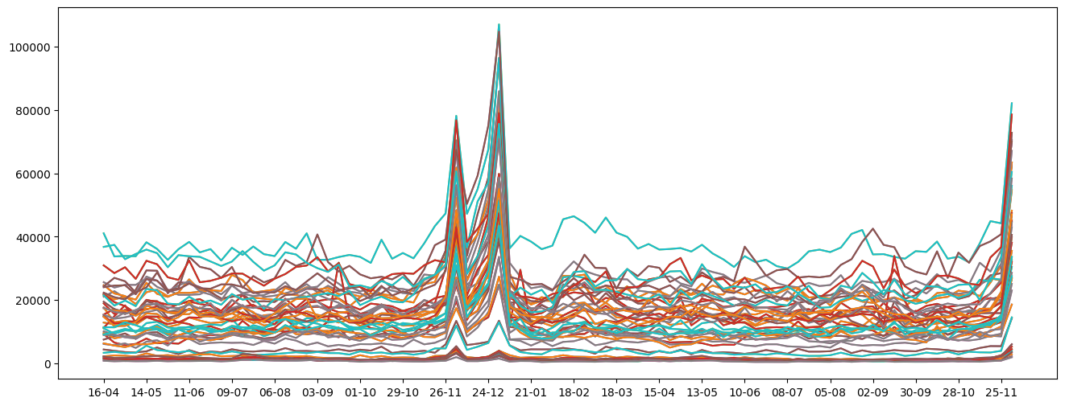
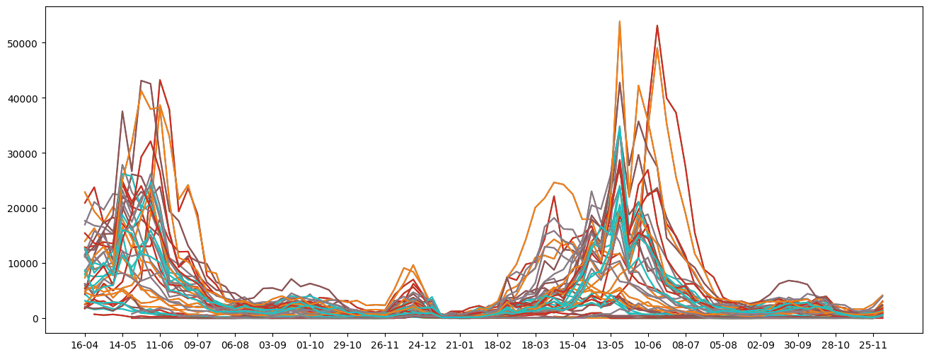
Looking at sales of all departments for different stores

Slide 12
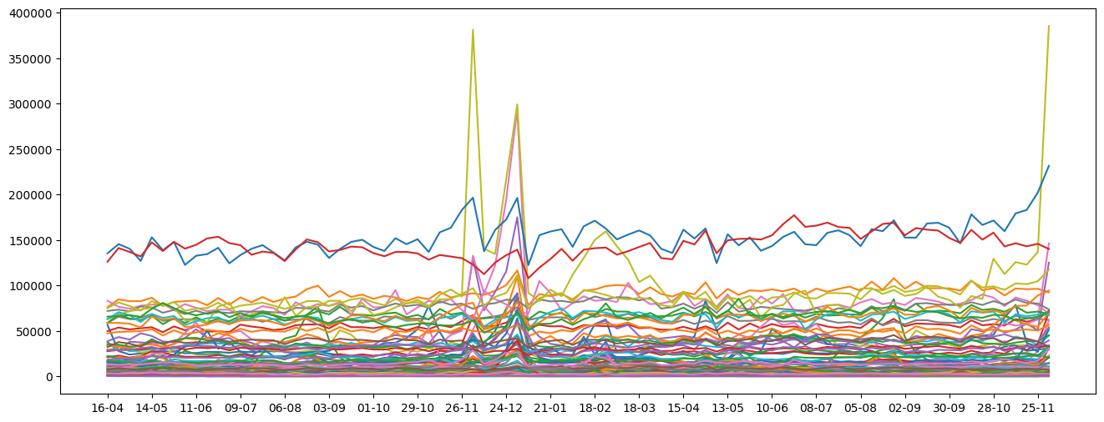
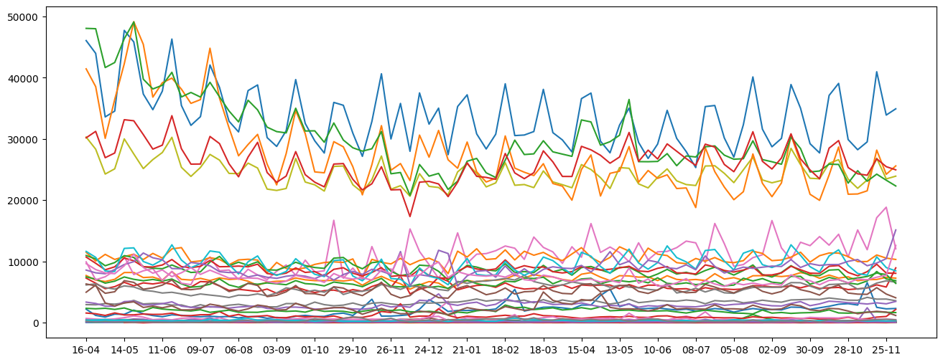
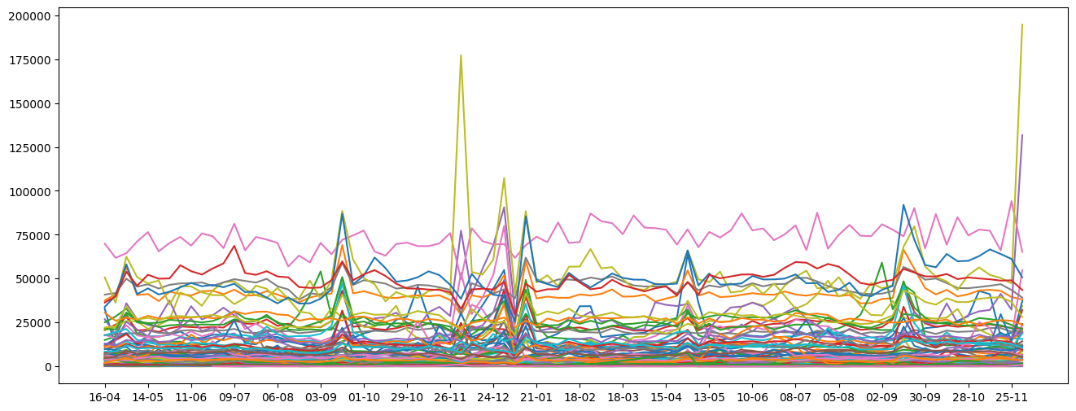
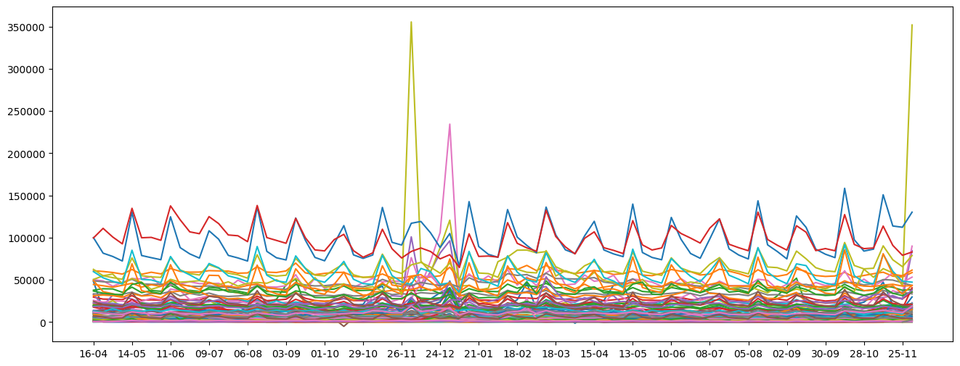
Looking at all stores for different departments

Slide 13
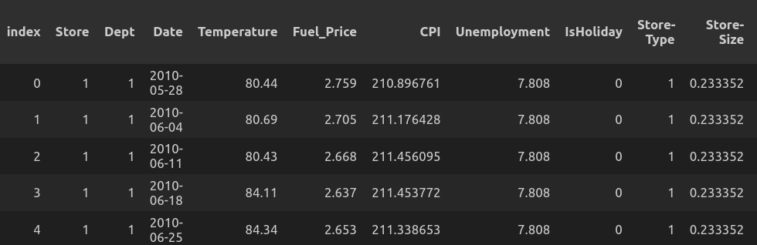
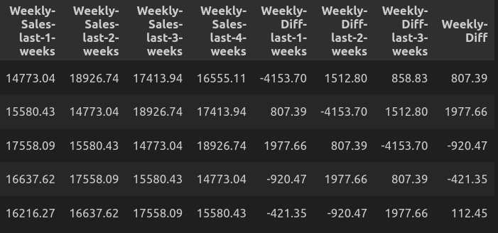
Linear Regression data

Slide 14
We will use Stochastic Gradient Descent in order to learn linear regression
We will train with MSE as out loss function but use RMSE to evaluate

Slide 15
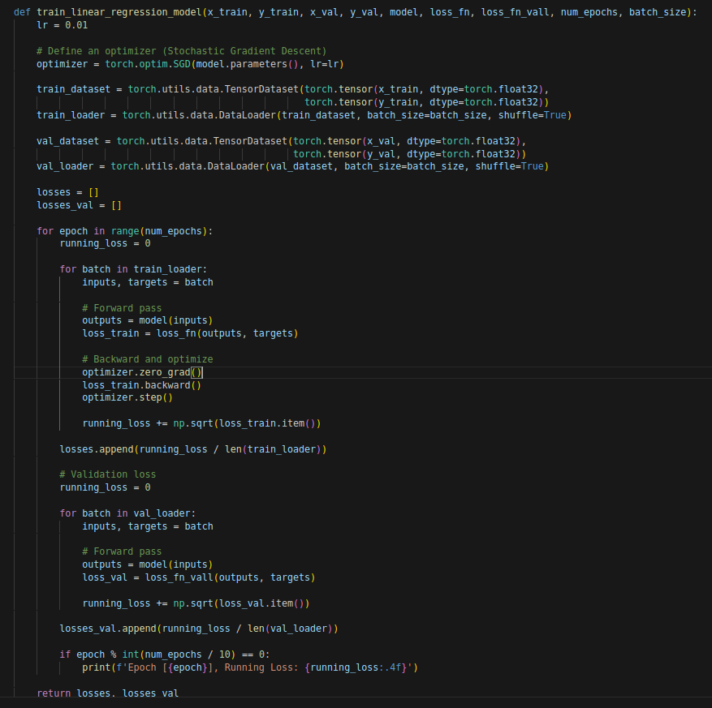
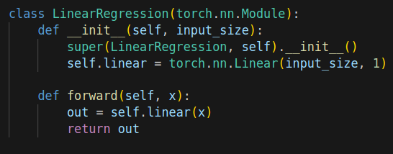
model
training

Slide 16
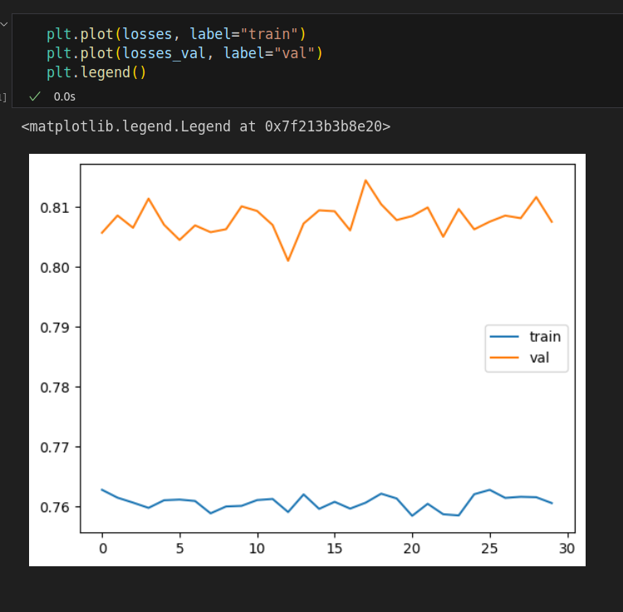
Loss function
Is it really learning
?

Slide 17
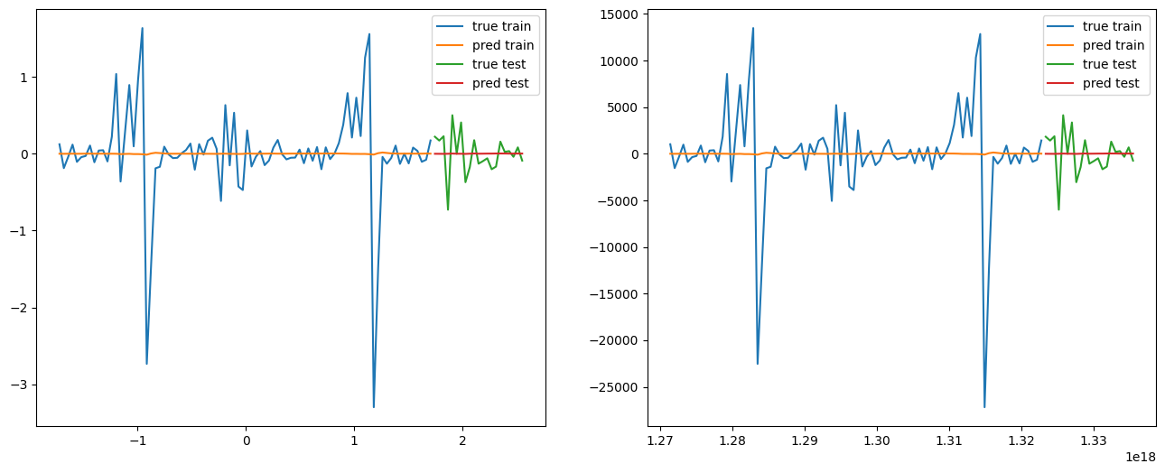
normalized
Non normalized

Slide 18
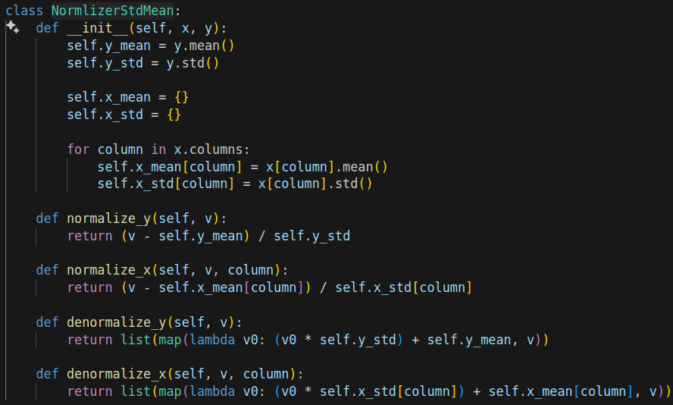
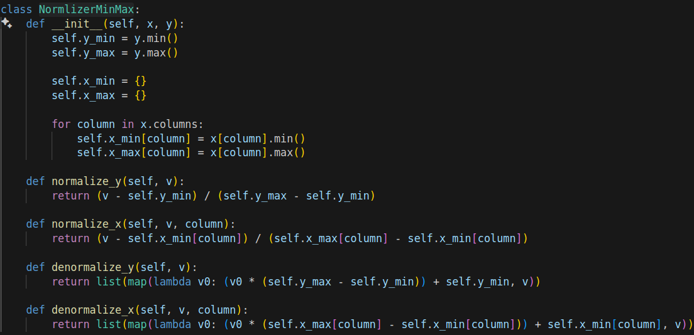

Slide 19
Model(same as before)
Training also the same

Slide 20
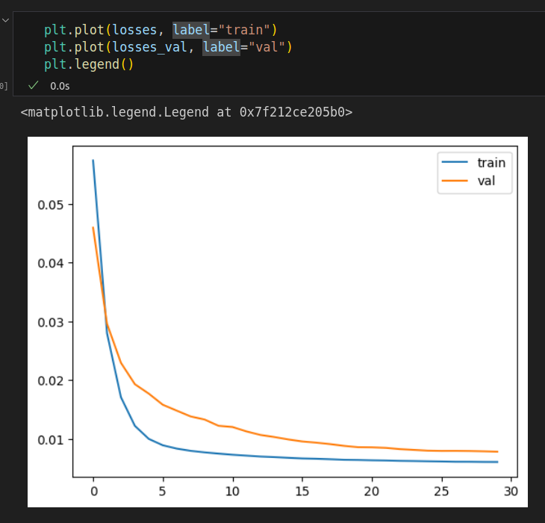
Loss function before and after test

Slide 21
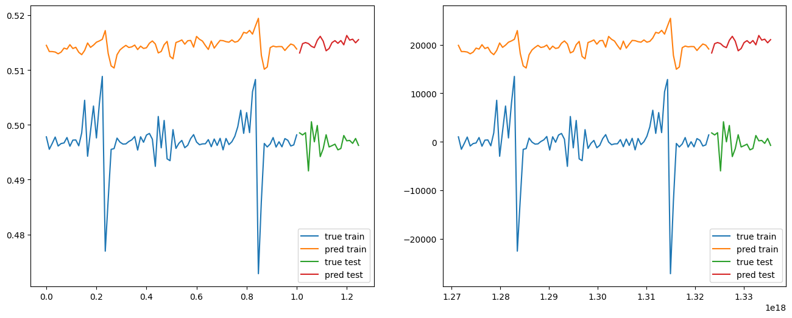
normalized
Non normalized

Slide 22
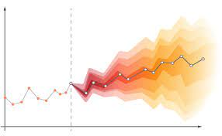
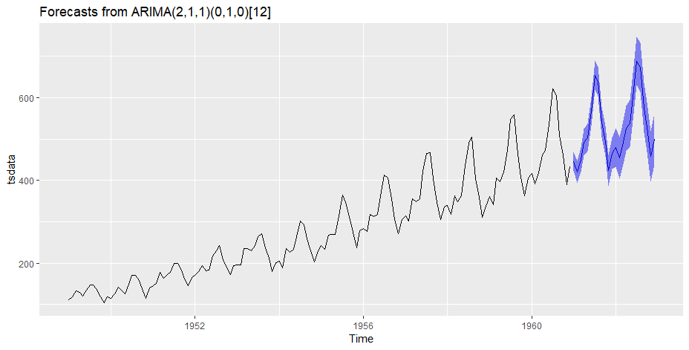
Time prediction is not easy

Slide 23
RNN(specifically LSTM) to the rescue
Has built in time flow
Is proven to be effective
Already solved the vanishing gradient problem
Has comparitively low number of weights for the amount of data

Slide 24
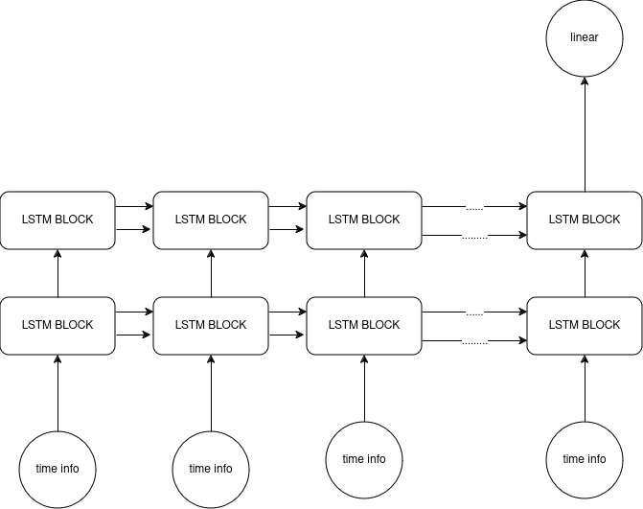
Our architecture
Two layered LSTM
Hidden state passed through each block =50
At each time period we get the all the relveant data from today(including sin cos of the date instead of the date)
Additionally we add the last week's week-diff

Slide 25
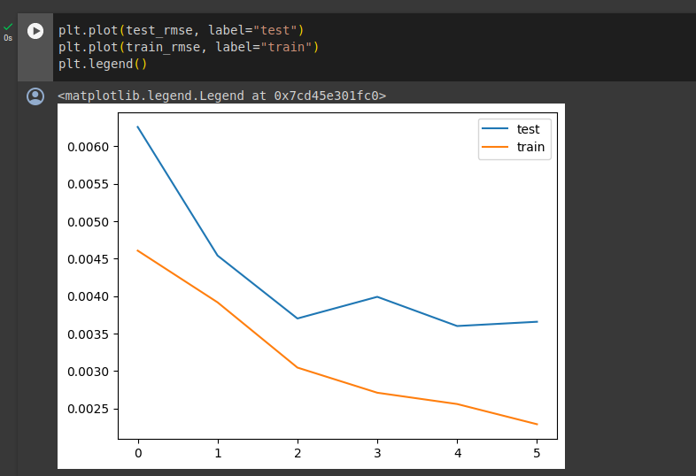
Result after 5 epochs with 5 LSTM layers (seems to be overfitting but cant be sure)

Slide 26
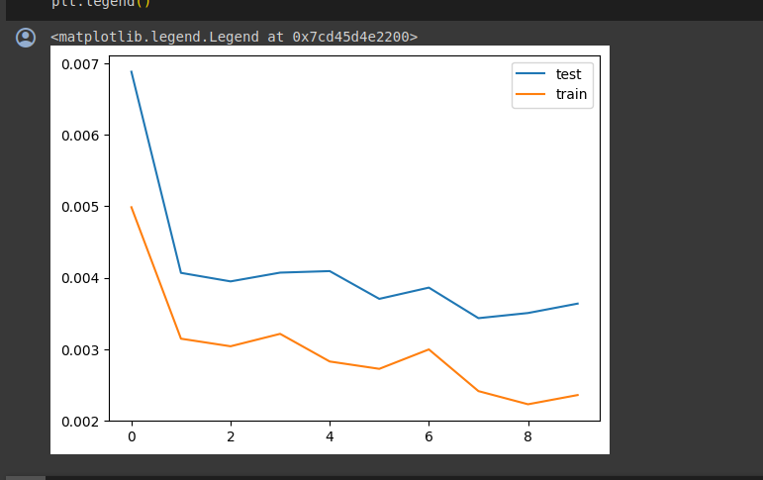
Results after 30 epochs with only 2 LSTM layers(observed every 3 epochs)

Slide 27
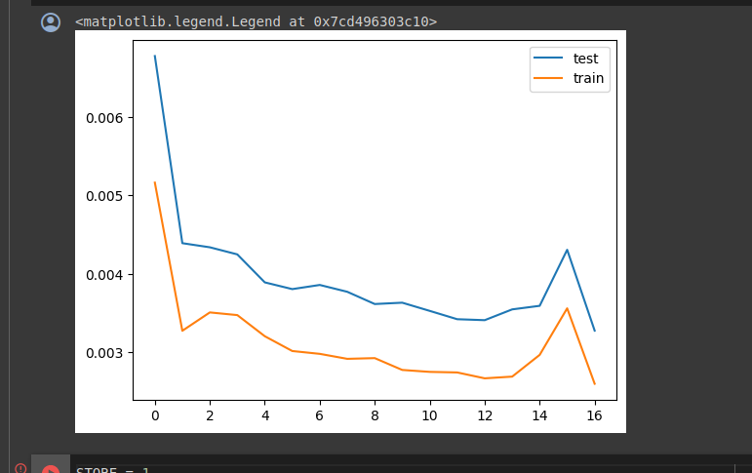

Need to solve overfitting problem.... Dropout!!!(0.2) and 50 epochs(observed every 3 epochs)

Slide 28
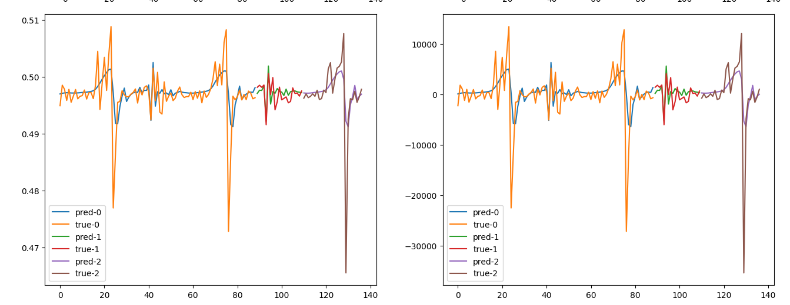
Observed results in arbitrary store and specific department ( dept=3)

Slide 29
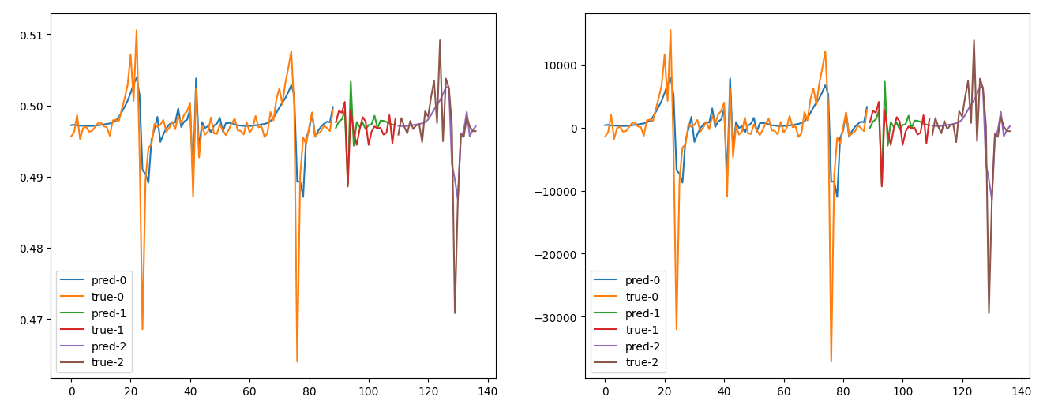
Observed results in the same department but at a different store

Slide 30
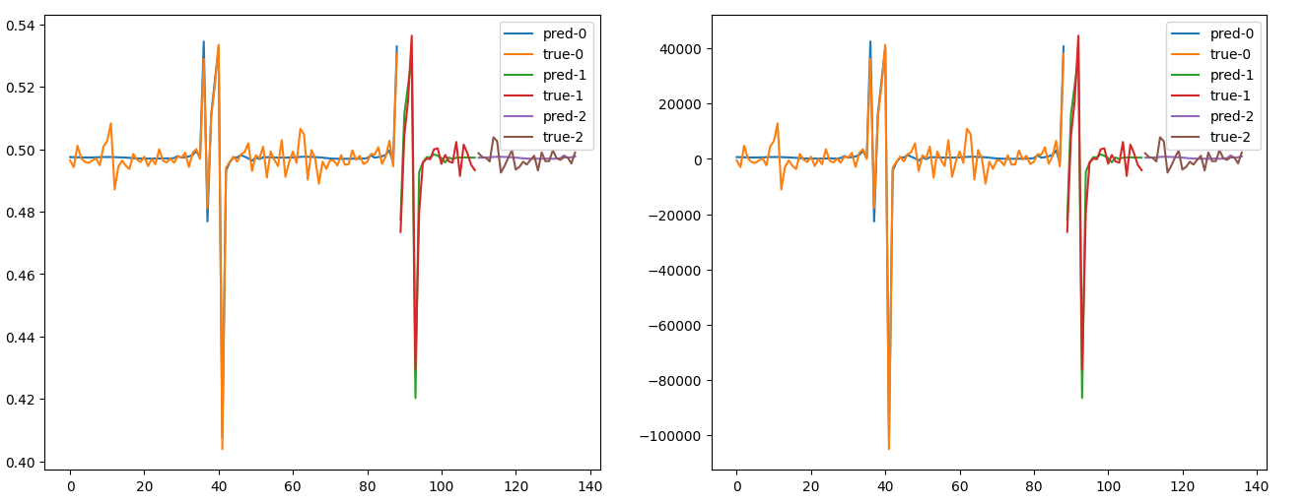
Results in a different department

Slide 31
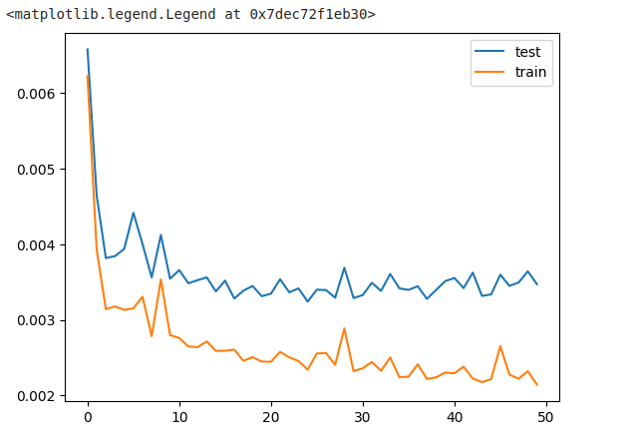
Using lookback = 10 AND 150 EPOCHS

Slide 32
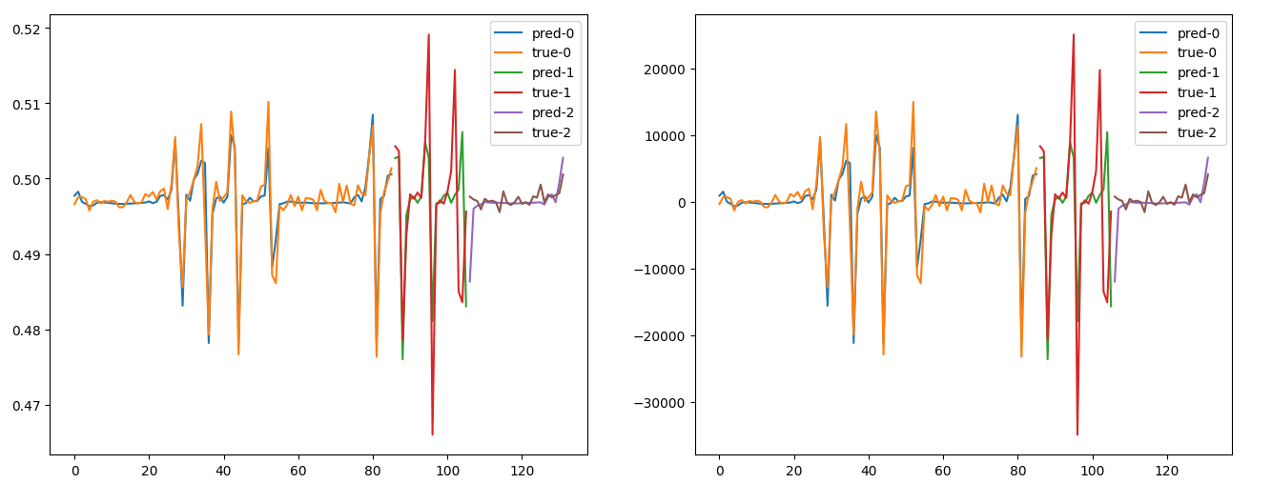
Results

Slide 33
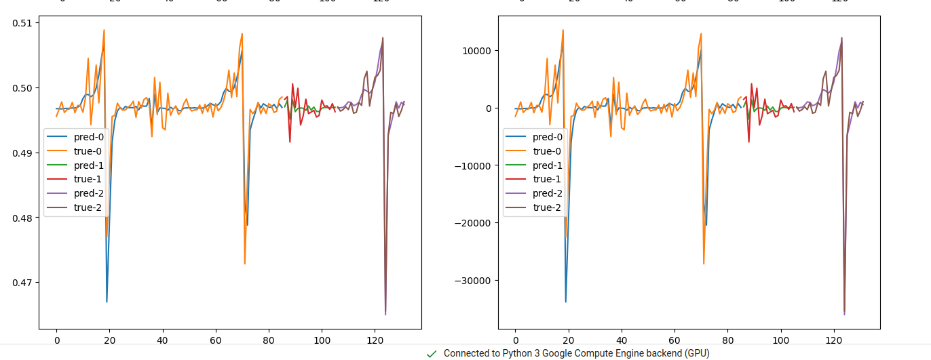
Results

Slide 34
And now clap for the final score

Slide 35

Thank you
We got Loss of 0.0026
Lior Shiboli and Omer Priel

